Slide 1
Hutchinson Elementary Principal’s Report
February 16, 2023
Presented by Ms. StJoy

Slide 2
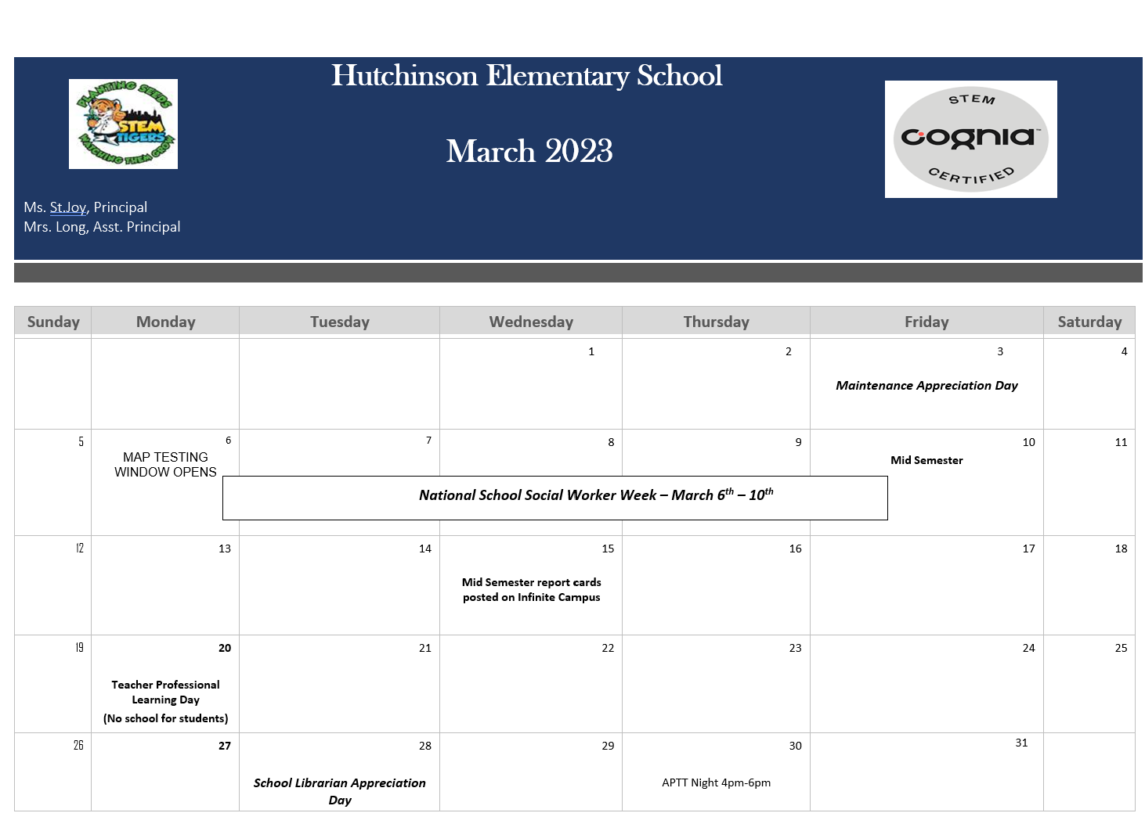
Upcoming
Winter Break Week of February 20th
February 28th Dress in African attire

Slide 3
MAP TESTING WINDOW
March 6th- 10th - MAP Growth Reading K-5th Grade 8:00 - 10:30
March 13th-17th - MAP Growth Math K-5th Grade 8:00 - 10:30
March 27th- 31st - MAP Growth Fluency Pre- K-5th Grade 8:00 - 10:30

Slide 4
65 Parents attended in the Fall
58 Parents attend in the Winter
Next meeting is March 30th

Slide 5
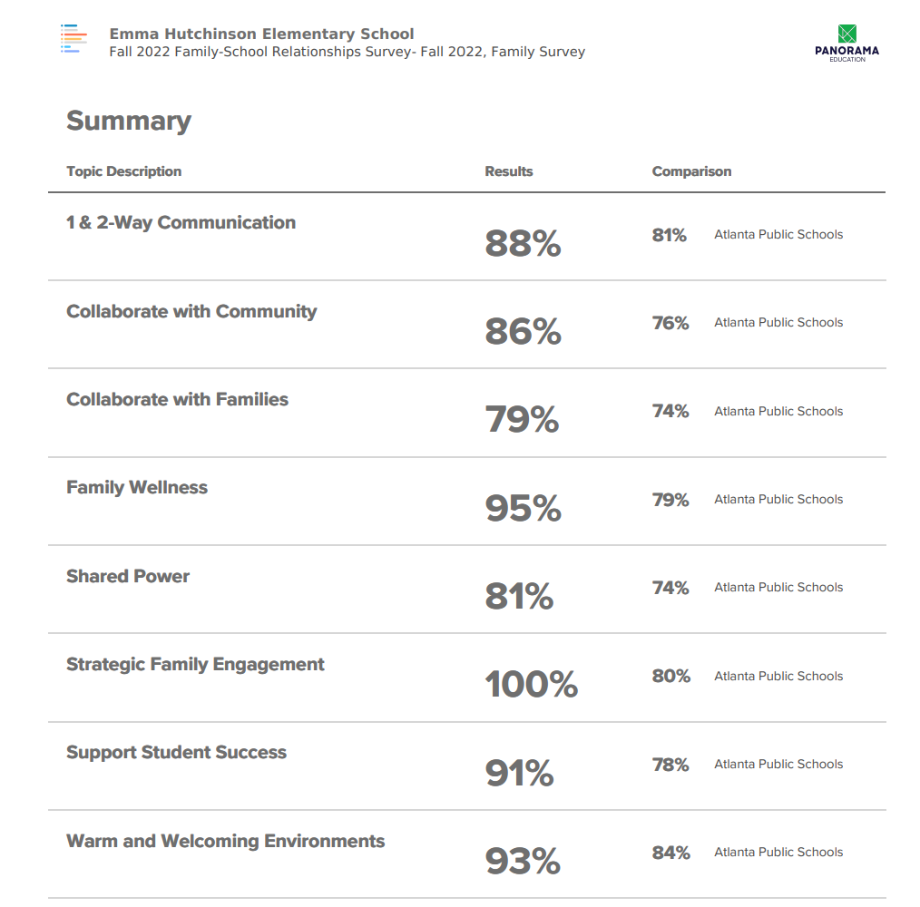
Panorama Education
Fall 2022 (December)
Family-School Relationship Survey Results

Slide 6
Next Go Team Meeting
3/16 @ 5pm

